Slide 1

Climate Change research at TTU: potential for collaborations to build a better future
Nick Smith
Associate Professor, Biology
Director, TTU Climate Center
nick.smith@ttu.edu
Climate Center

Slide 2
Outline
Brief introduction to me and my background
TTU Climate Center
Who we are
What we do
Where we are going
Time for discussion
Climate Center
nick.smith@ttu.edu

Slide 3
Outline
Brief introduction to me and my background
TTU Climate Center
Who we are
What we do
Where we are going
Time for discussion
Climate Center
nick.smith@ttu.edu

Slide 4
Nick’s background
PhD from Purdue University in Biology (2016)
Postdoctoral training at Lawrence Berkeley National Lab (2017)
Tenure track at TTU in Biology since 2017
Appointed Climate Center Director in 2024
Expertise
Plant ecophysiology
Terrestrial ecosystem ecology
Biosphere-atmosphere feedbacks
Climate Center
nick.smith@ttu.edu

Slide 5
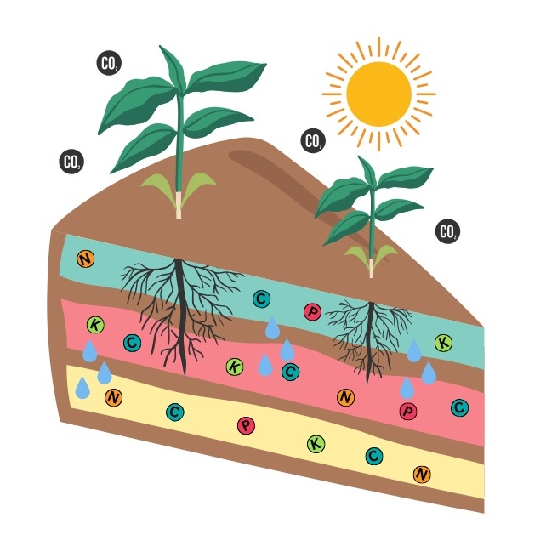
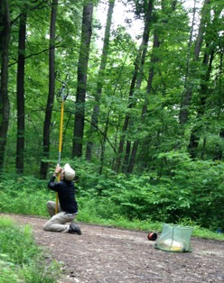
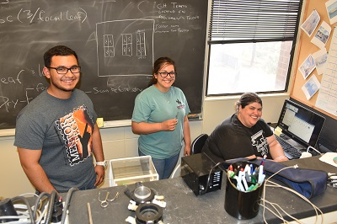
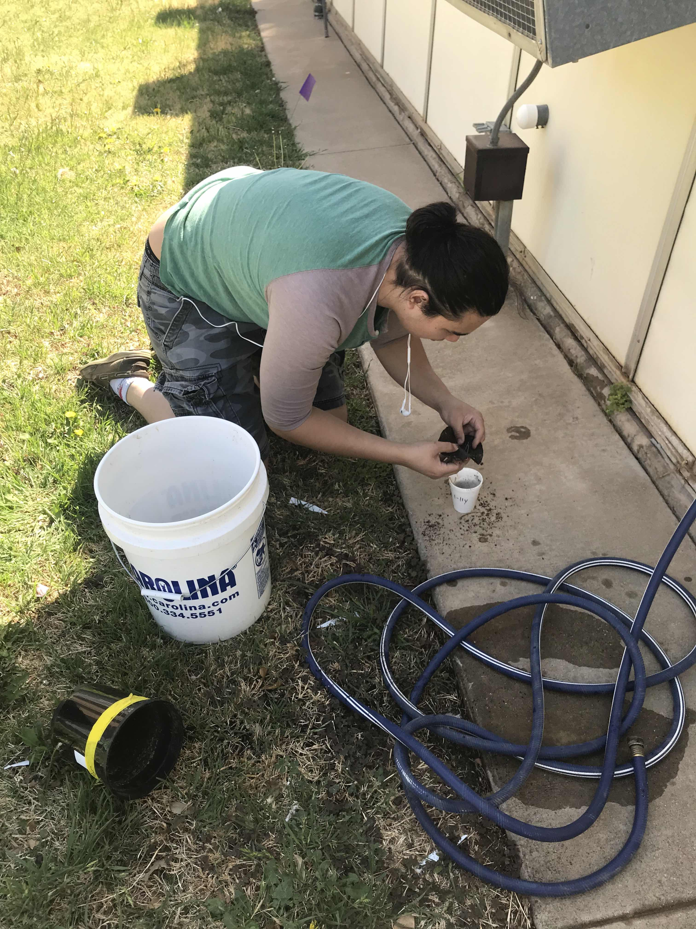
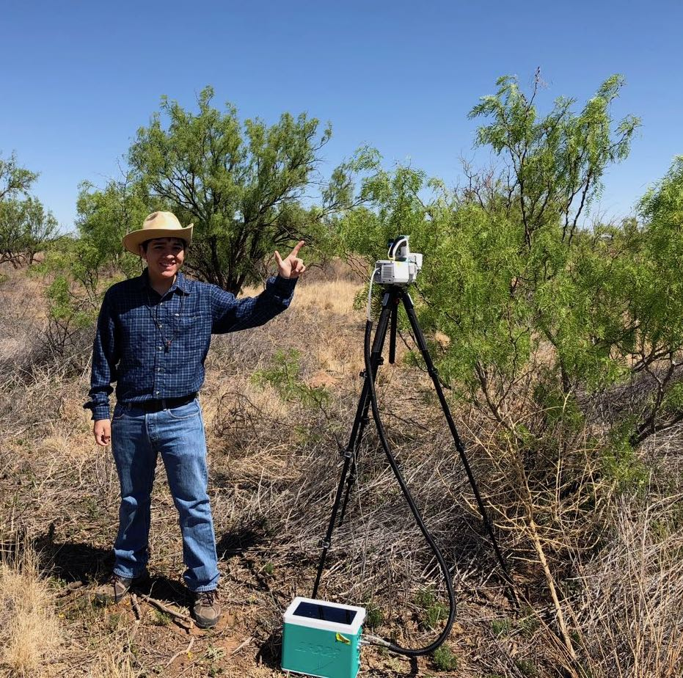
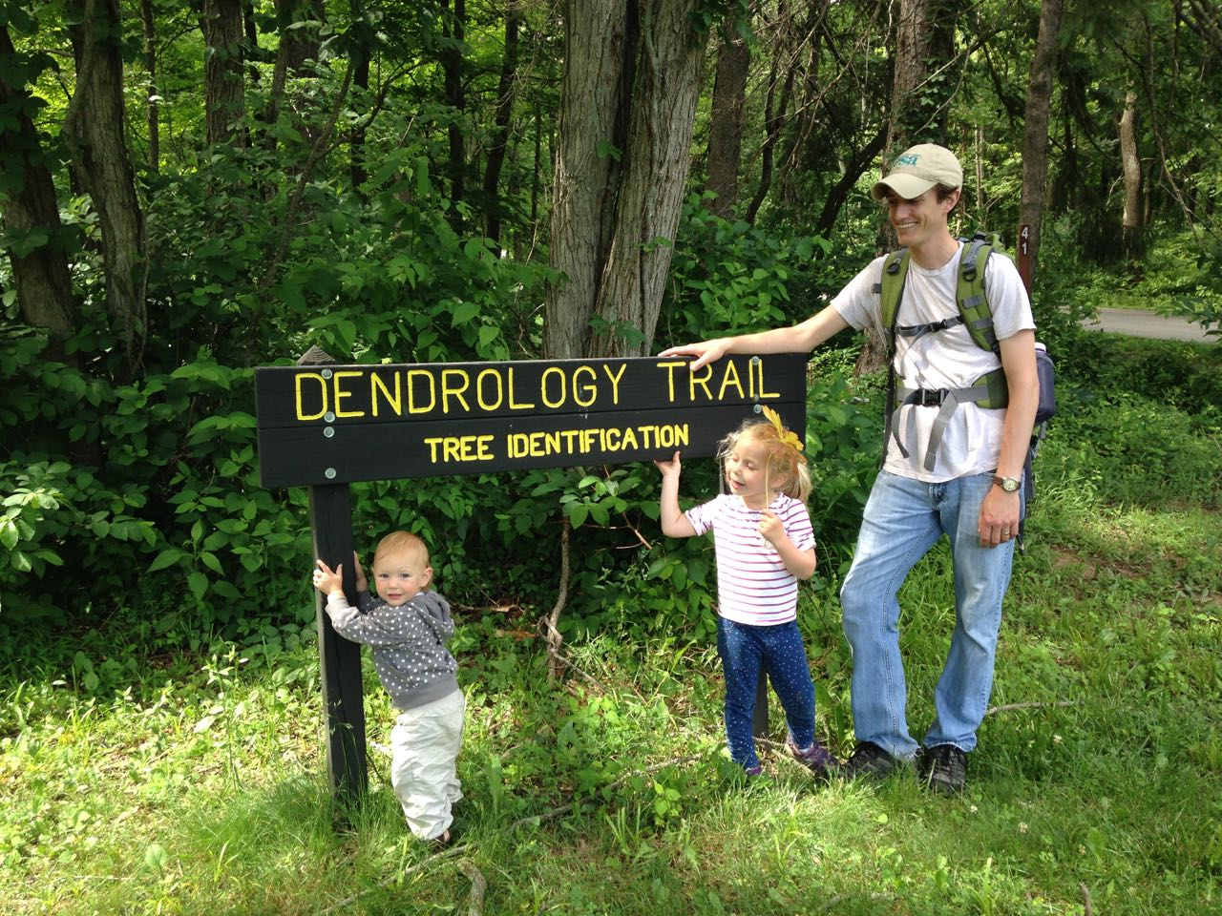
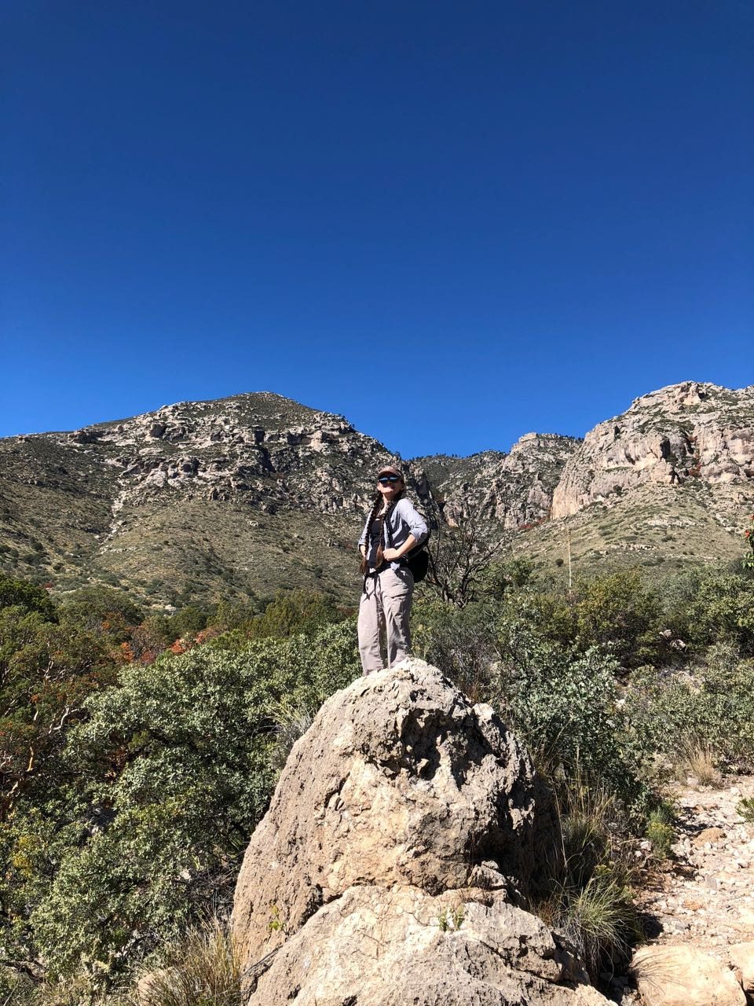
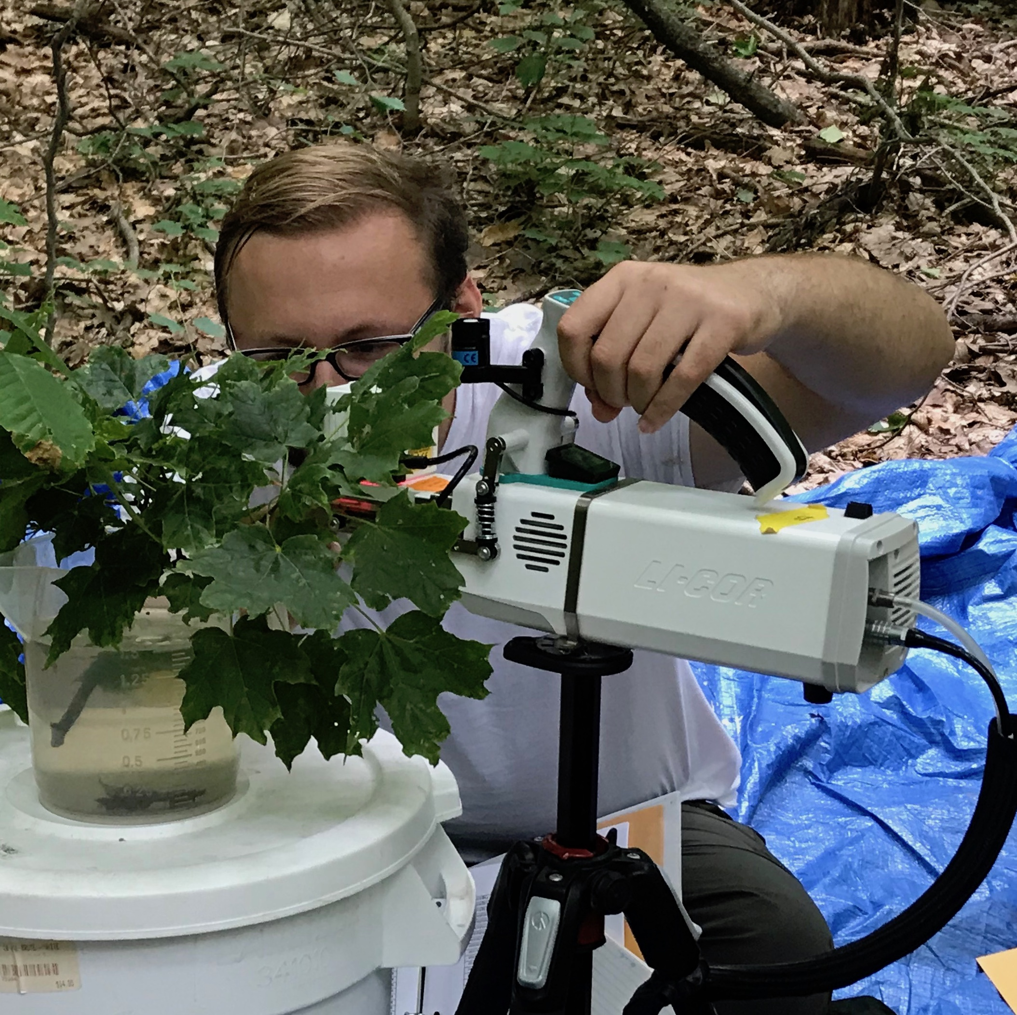
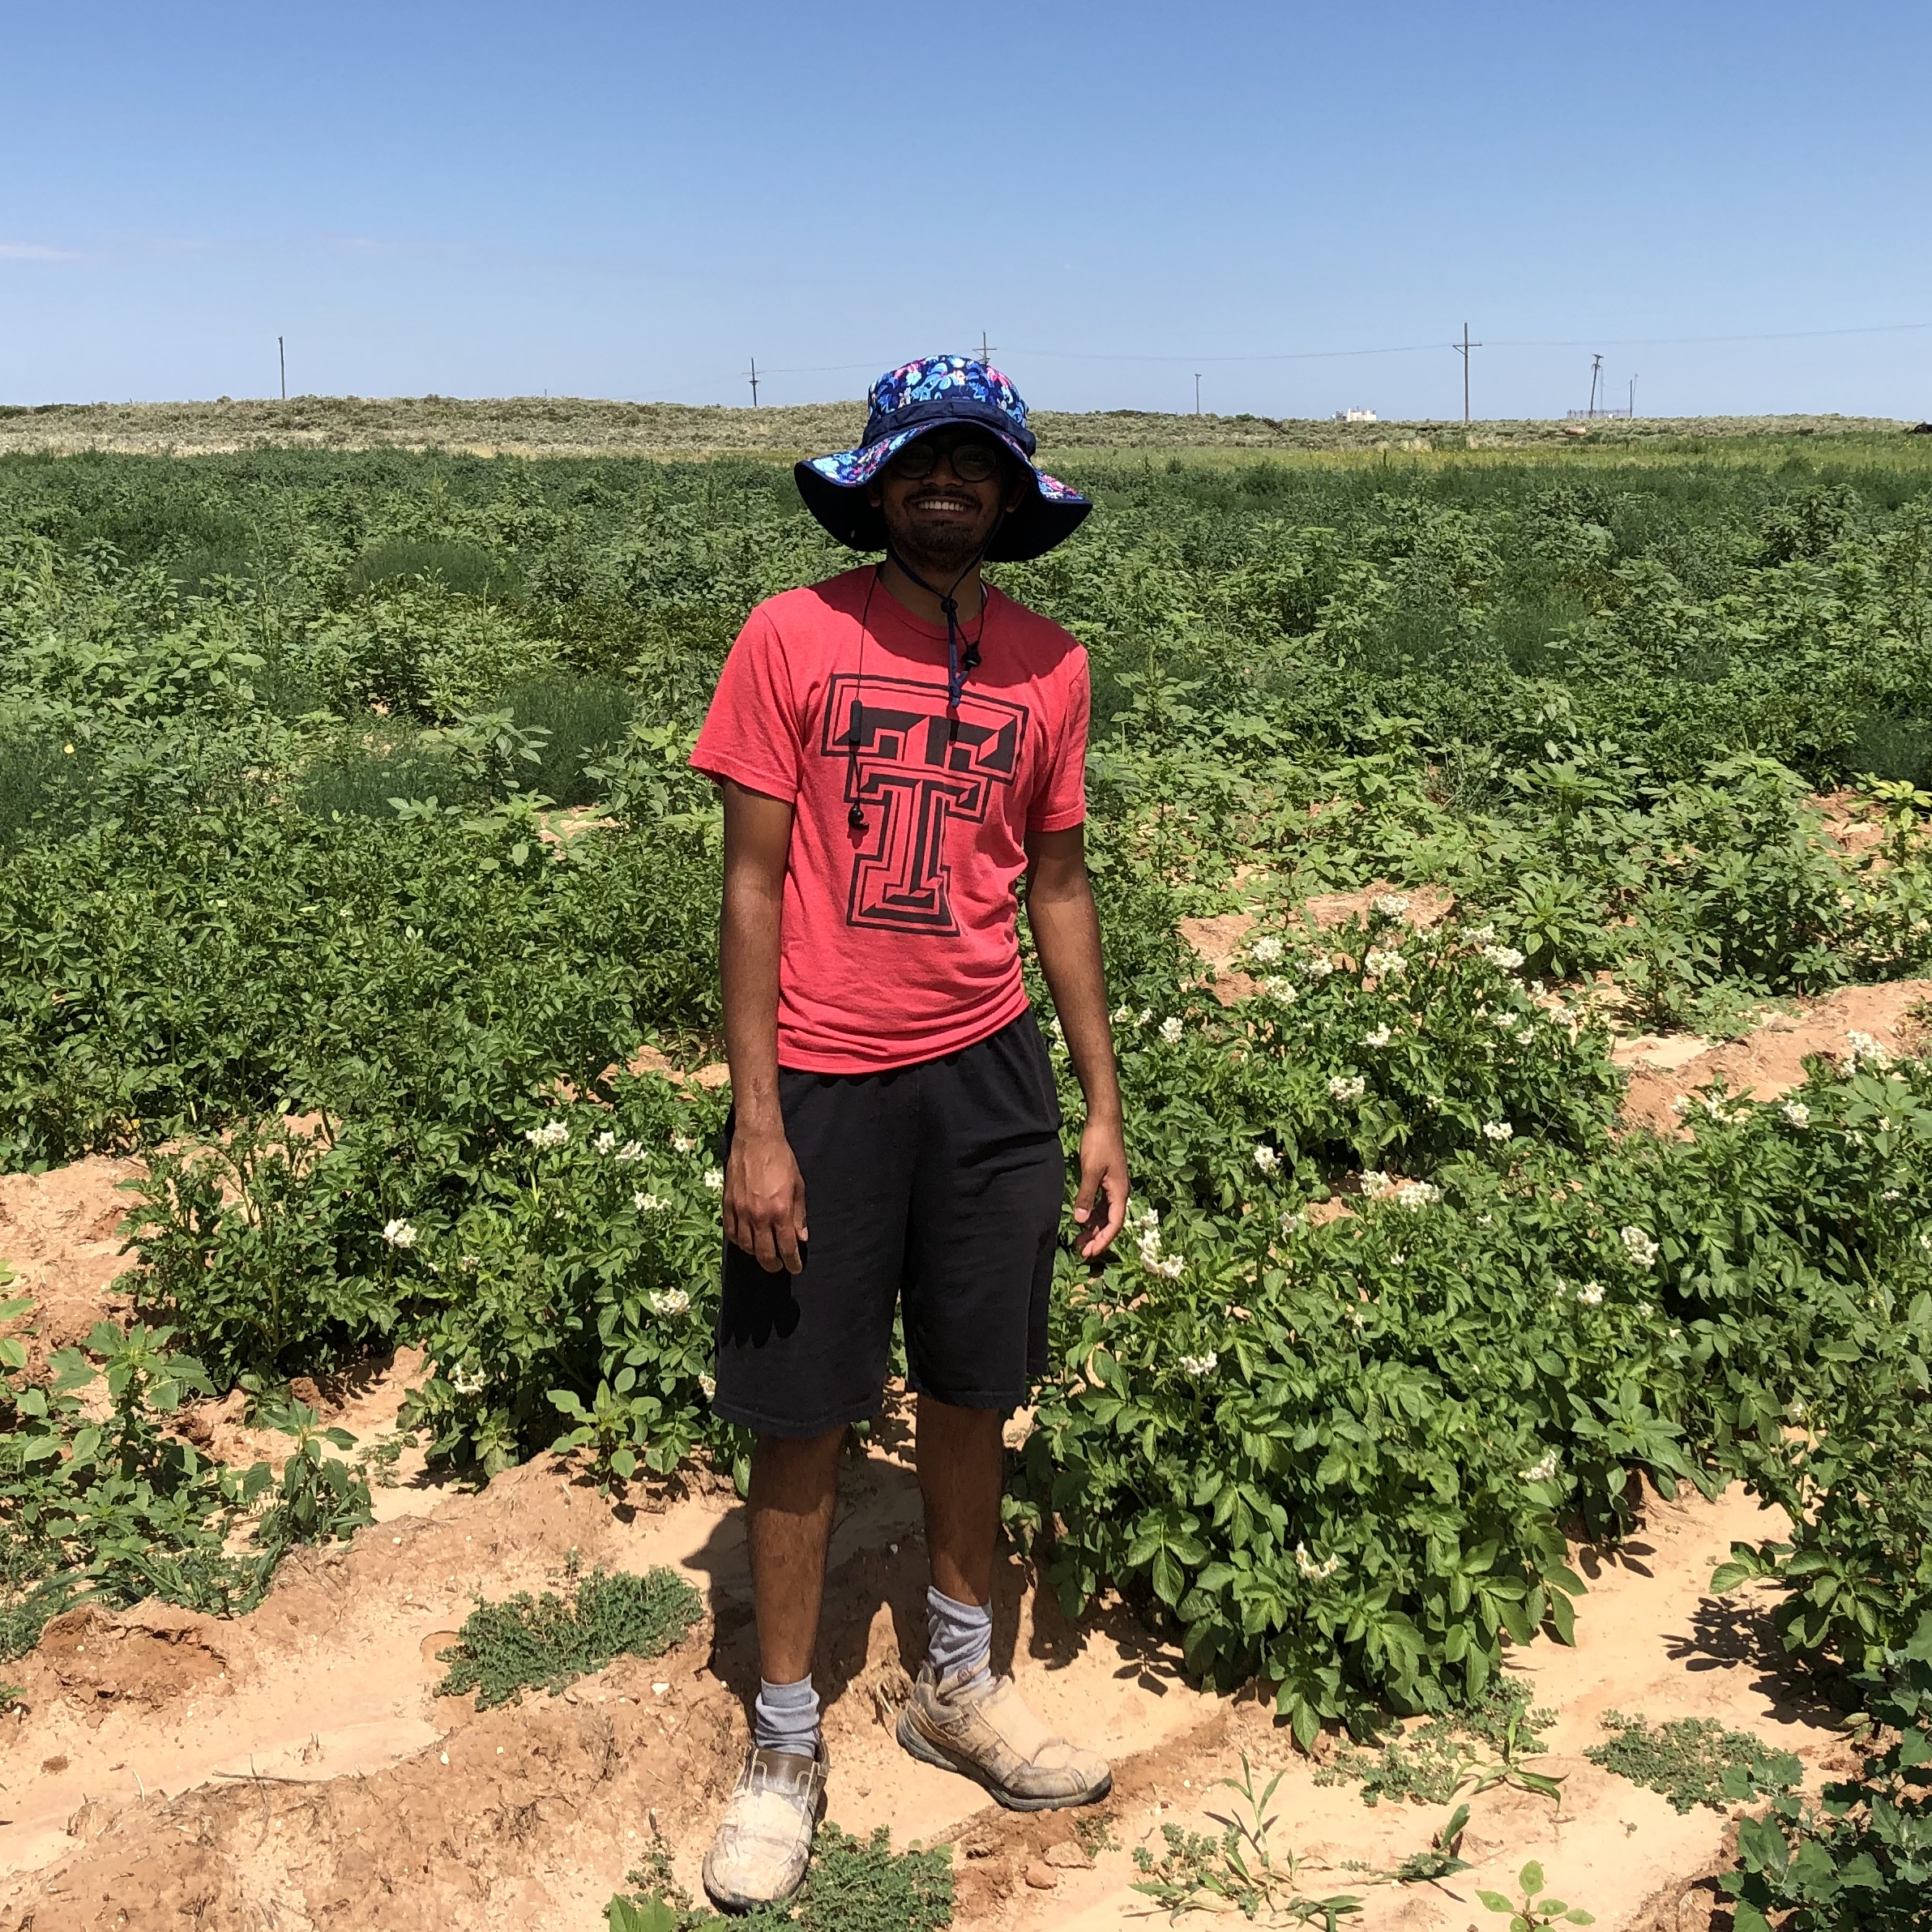
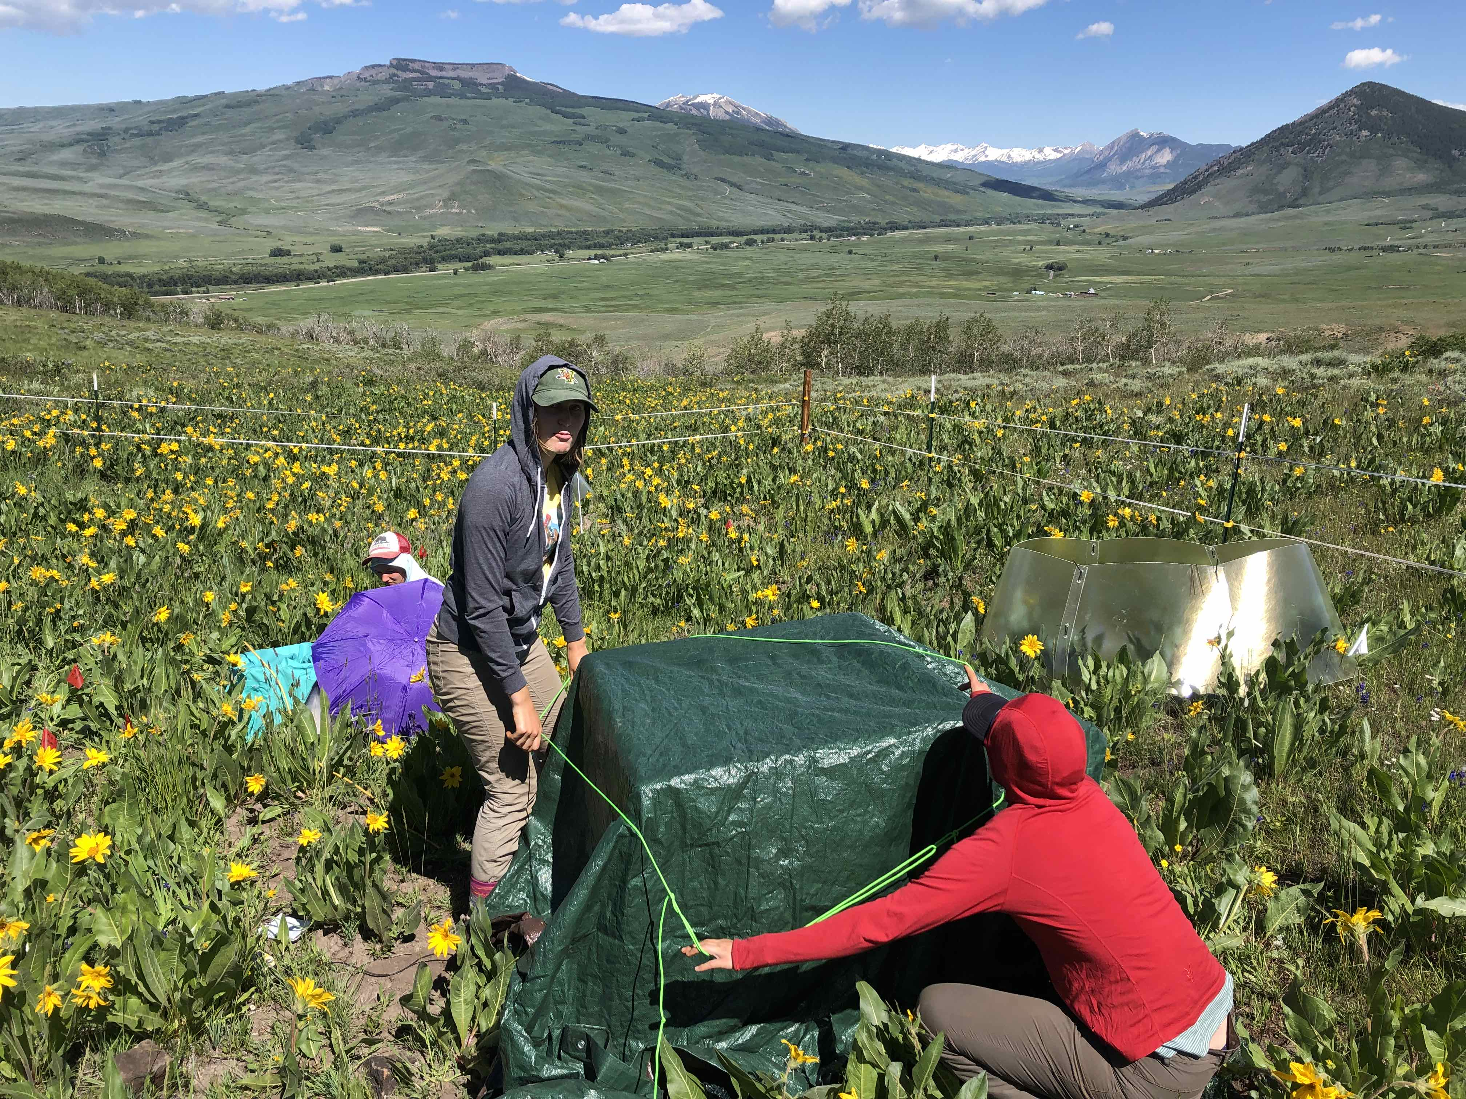
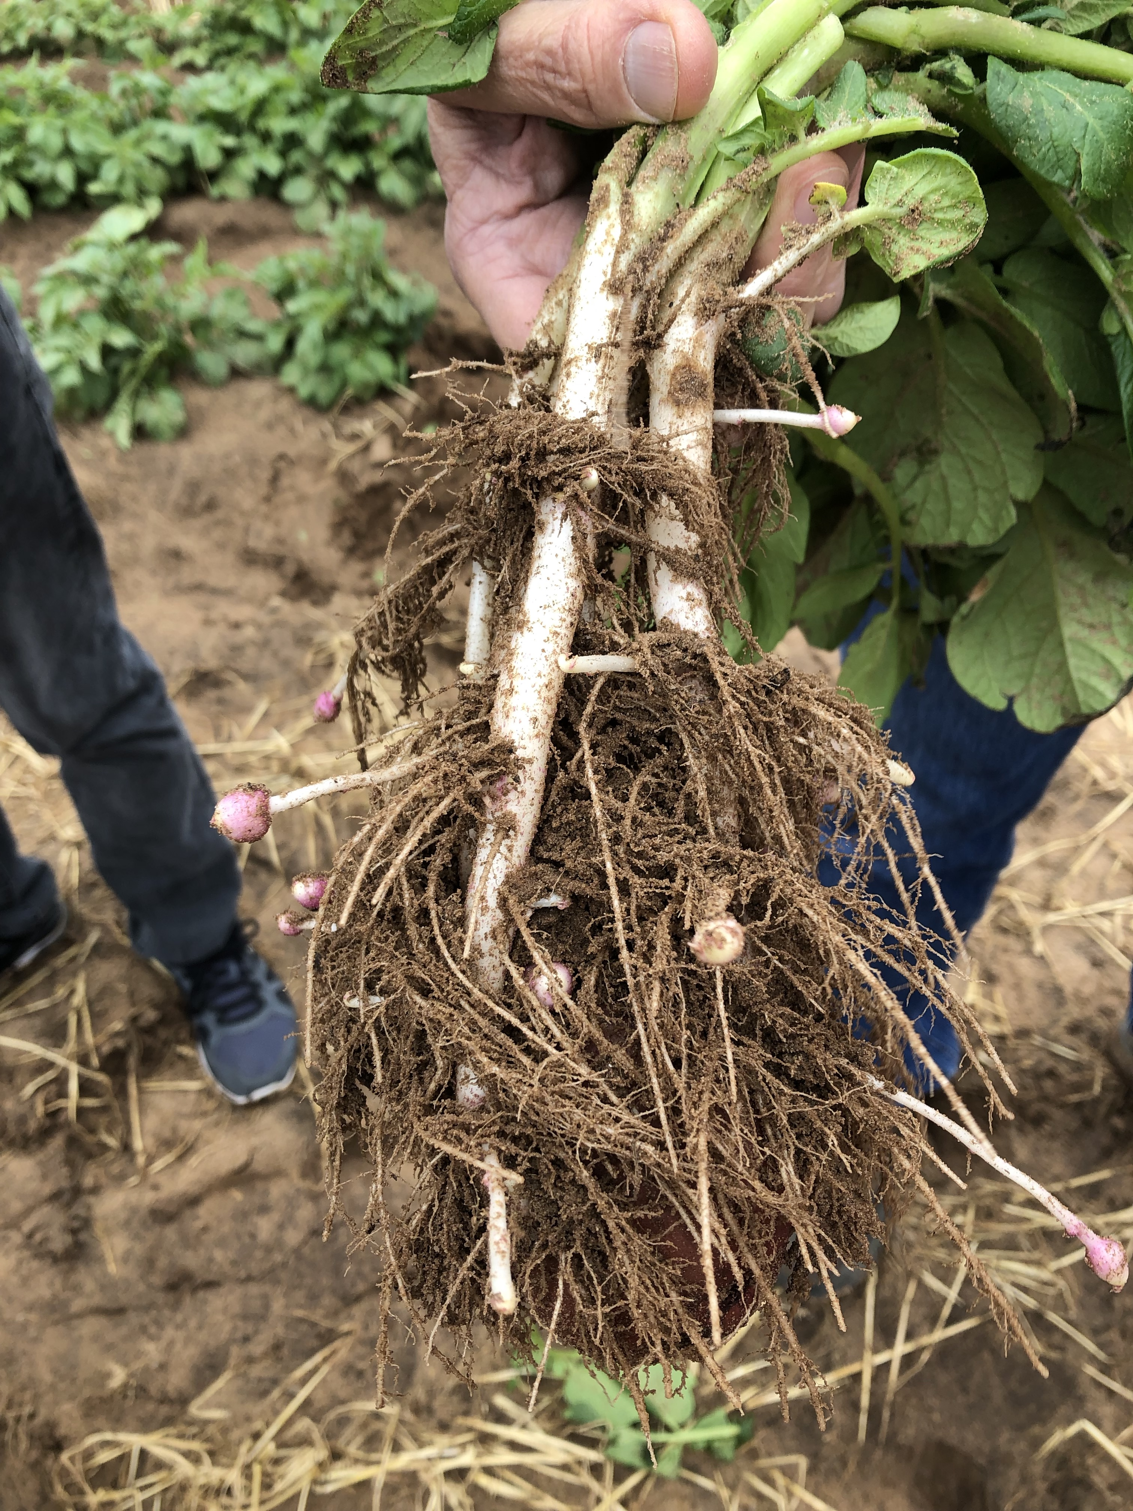
PhUnFETTy Lab: overview
PHysiology for UNderstanding the Functioning of Ecosystems at TTU
Feedbacks between global change, plants, and ecosystem services
Focus on plant physiology: what do plants do and does it matter?
Climate Center
nick.smith@ttu.edu

Slide 6
PhUnFETTy Lab: current projects
LEMONTREE: Land Ecosystem Models based On New Theory, obseRvations, and ExperimEnts
Funding: Schmidt Futures, $10 million/$800k to TTU (2020-2025)
Goal: develop a terrestrial biosphere model from first principles
Improving understanding and prediction of photosynthetic acclimation to global change
Funding: US Natl. Science Foundation, $1.1 million/100% TTU (2021-2026)
Goal: improve understanding and ability to predict photosynthesis
Defining the mechanisms and consequences of mutualism reorganization in the Anthropocene
Funding: US Natl. Science Foundation, $3.6 million/$1.2 million to TTU (2022-2027)
Goal: understand mechanisms underlying plant species invasion

Slide 7
Outline
Brief introduction to me and my background
TTU Climate Center
Who we are
What we do
Where we are going
Time for discussion
Climate Center
nick.smith@ttu.edu

Slide 8
Outline
Brief introduction to me and my background
TTU Climate Center
Who we are
What we do
Where we are going
Time for discussion
Climate Center
nick.smith@ttu.edu

Slide 9
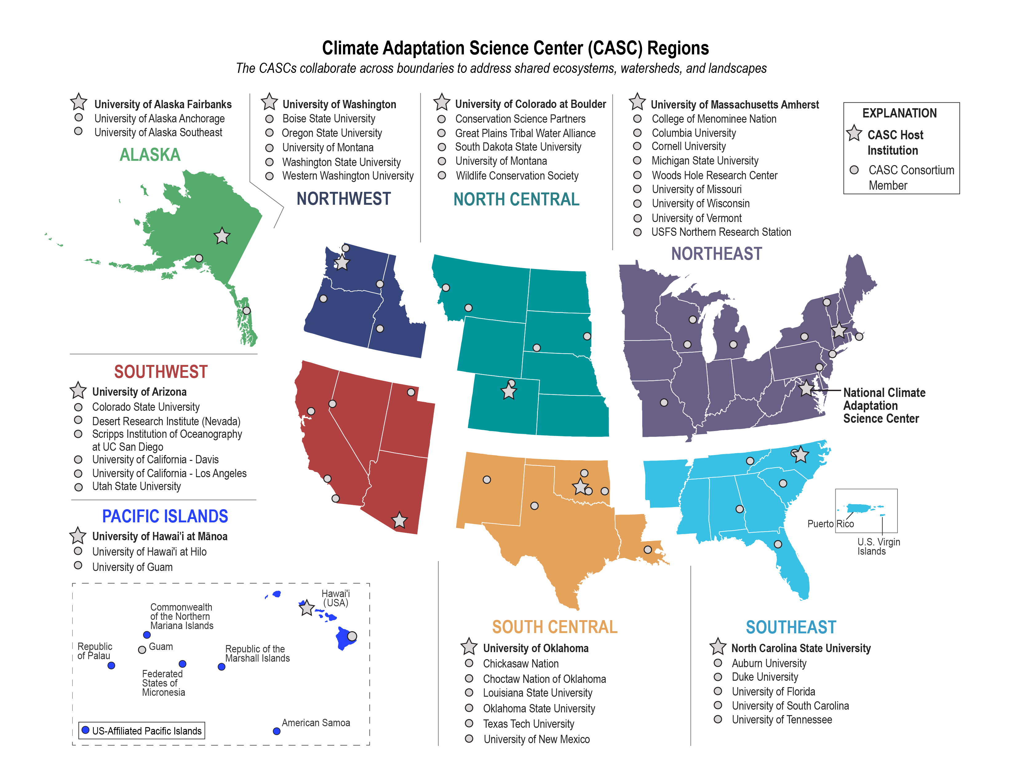
TTU Climate Center: Who we are
Member of USGS-funded Climate Adaptation Science Centers (CASCs)
Climate Center
nick.smith@ttu.edu

Slide 10
TTU Climate Center: Who we are
Consortium institution of the South Central CASC (SC-CASC)
Climate Center
nick.smith@ttu.edu

Slide 11
TTU Climate Center: Who we are
SC-CASC:
Provide decision makers with the science, tools, and information they need to address the impacts of climate variability and change
Transform how climate science is conducted and applied in the south-central US
Support big thinking, including multi-institutional and stakeholder-driven approaches to assessing the impact of climate on natural and cultural resources
Climate Center
nick.smith@ttu.edu

Slide 12
TTU Climate Center: Who we are
>100 active members
Mostly faculty
Students and postdocs
12 TTU Colleges
36 TTU Departments
Open to anyone interested in, passionate about, or doing climate-related work
Climate Center
nick.smith@ttu.edu

Slide 13
Outline
Brief introduction to me and my background
TTU Climate Center
Who we are
What we do
Where we are going
Time for discussion
Climate Center
nick.smith@ttu.edu

Slide 14

TTU Climate Center: What we do
Serve as regional hub for climate change
Work with community members and stakeholders
All areas of research that intersect with climate
Monthly research and outreach meetings
Events
Informational events on and off campus
Science by the Glass
Climate Center
nick.smith@ttu.edu

Slide 15
Outline
Brief introduction to me and my background
TTU Climate Center
Who we are
What we do
Where we are going
Time for discussion
Climate Center
nick.smith@ttu.edu

Slide 16
Outline
Brief introduction to me and my background
TTU Climate Center
Who we are
What we do
Where we are going
Time for discussion
Climate Center
nick.smith@ttu.edu

Slide 17
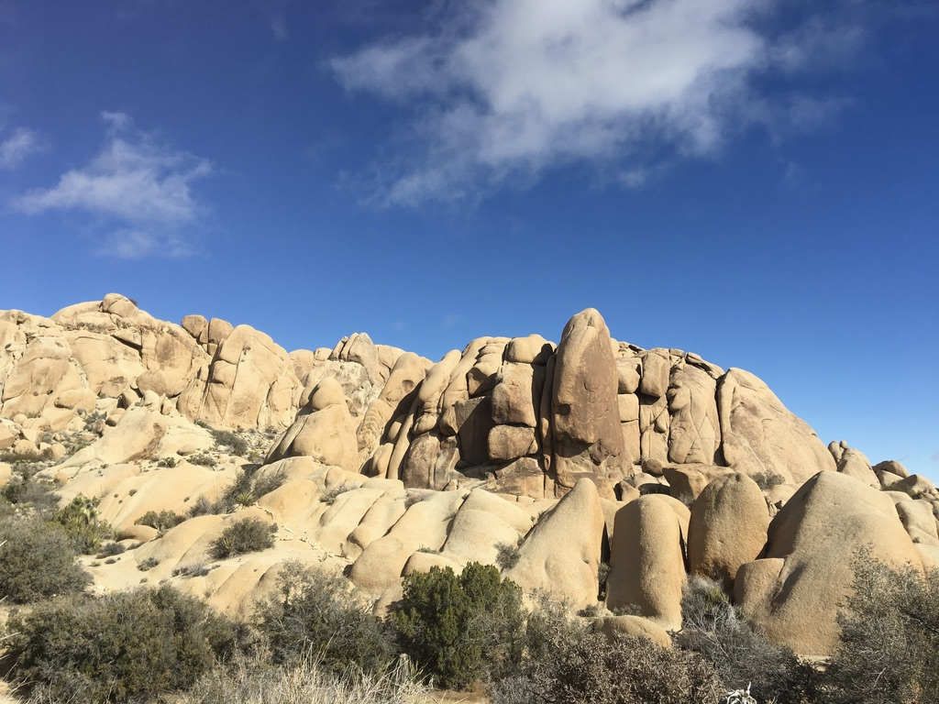
Let’s chat!
Climate Center
nick.smith@ttu.edu

